Slide 1
JAVA ARCHITECTURE
What is Java Architecture
Components of Java
OOPS Concept Jyoti Rekha Giri

Slide 2
Java Architecture combine the process of Compilation and Interpretation.
Compilation : A Compiler reads program in one-go and gives output if the program is correct else an error.
Interpretation : It reads a program Line-by-Line.
Reading every expression gives output if the program is correct.
It gives error when it encounters the first mistake in any line of code.

Slide 3
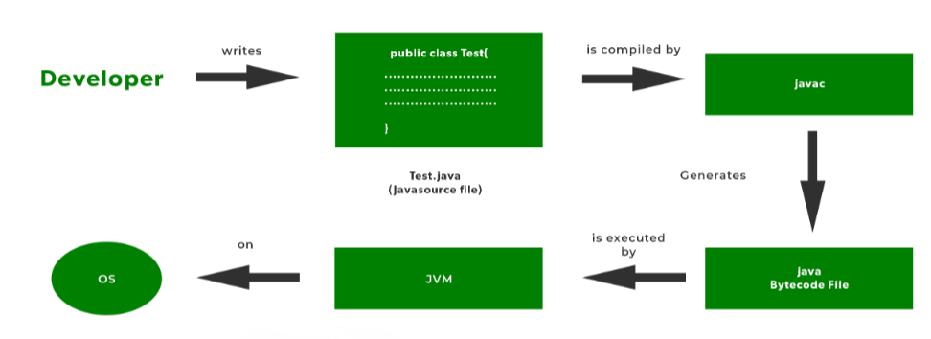
ARCHITECTURE
Java code converted into Byte code which is done by Java Compiler.
Byte code converted into Machine Code is done by JVM.
The machine code which is executed directly by Machine i.e, OS.

Slide 4
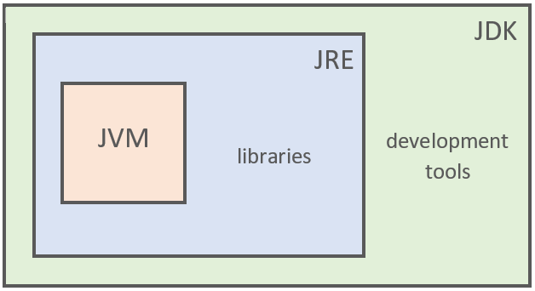
COMPONENTS OF JAVA ARCHITECTURE
1. JVM
2. JRE
3. JDK

Slide 5
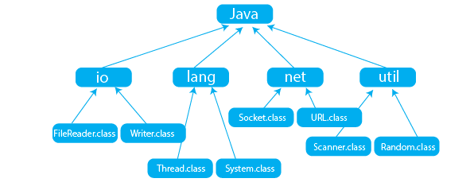
Development Tools : java, javac, jar, Javadoc
Library classes : Packages, Classes

Slide 6
JVM (JAVA VIRTUAL MACHINE)
The JVM is a Java platform component that provides an environment for executing Java programs.
JVM interprets the bytecode into machine code which is executed in the machine in which the Java program runs.
Java Applications are called WORA (Write Once Run Anywhere).

Slide 7
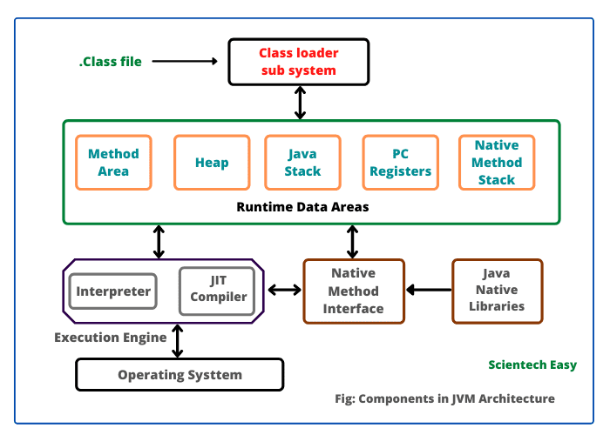
JVM ARCHITECTURE

Slide 8
What is OOPS?
Whenever we develop some program using Class and Objects than it is called Object Oriented Programming System.
Class
A class can also be defined as a blueprint from which you can create an individual object. Class doesn’t consume any space
Objects
Any entity that has state and behavior is known as an object. For example, a chair, pen, table, keyboard, bike, etc. It can be physical or logical object.

Slide 9
OOPS Concepts
Inheritance:
Inheritance is one of the Basic Concepts of OOPs in which one object acquires the properties and behaviors of the parent object.It’s creating a parent-child relationship between two classes.
Inheritance allows a class (subclass) to inherit the properties and methods of another class (superclass). This promotes code reusability and establishes a relationship between classes.
Abstraction:
Abstraction involves hiding the complex reality while exposing only the essential parts. It reduces complexity by allowing the user to interact with the object at a high level without knowing the internal details.

Slide 10
Encapsulation:
Encapsulation is the concept of wrapping data (variables) and methods (functions) that operate on the data into a single unit, or class. It restricts direct access to some components, which can protect the integrity of the data and improve security.
Polymorphism:
Polymorphism allows objects of different classes to be treated as objects of a common superclass. It lets methods perform different tasks based on the object calling them.
Two types of Polymorphism:
1. Compile-Time (Static) Polymorphism(Method Overloading)
2. Run-Time (Dynamic) Polymorphism(Method Overriding)

